Slide 1
The Wumpus World
A Classic AI Reasoning Problem
Dr asifullah Khan
Muhammad Hammad Tahir

Slide 2
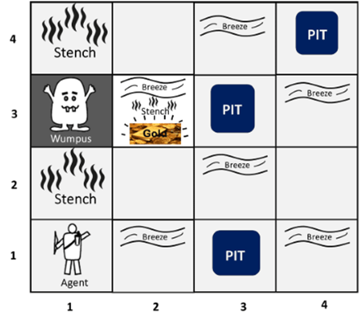
What is Wumpus World?
A 4x4 grid where an agent explores caves
Dangers:
Wumpus (monster) - gives stench in adjacent cells
Pits - give breeze in adjacent cells
Goal: Find the gold without dying
Percepts (What agent senses):
Stench = Wumpus nearby
Breeze = Pit nearby
Glitter = Gold here!
Scream = Wumpus died
Approaches:
Knowledge-Based (Symbolic) AI: Full Prolog Code
Neuro-Symbolic AI: Hybrid Architecture

Slide 3
What Is Prolog?
Prolog = Programming in Logic. It’s not like Python or C that “execute steps.” Instead, Prolog works on facts and rules — it reasons logically to find answers.
Concept | Meaning | Example
Fact | Something known to be true | breeze([1,2]).
Rule | A logical condition (if-then statement) | safe_move(L) :- not(pit(L)), not(monster(L)).
Query | A question you ask Prolog | ?- safe_move([2,2]).

Slide 4



example
John is a parent of Mary.
Mary is a parent of Ann.
Facts
Rule
X is a grandparent of Y if X is a parent of Z and Z is a parent of Y.
Query:
Find all Who such that john is a grandparent of Who.
Prolog answer:

Slide 5
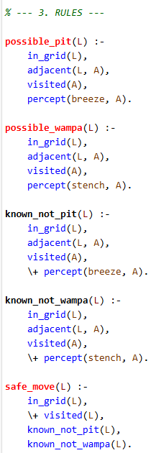
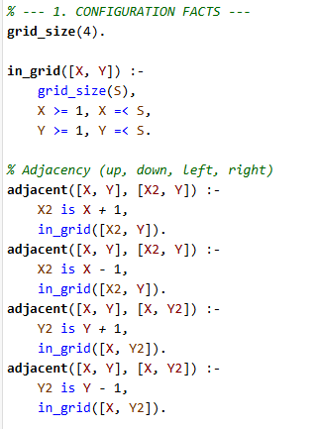
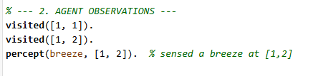
Knowledge-Based Implementation (PROLOG)
The agent has limited observations (facts) and bases its answers only on that information. For the remaining positions, where no information is available, it cannot determine whether the cell is safe or not.
4 x 4 Grid environment

Slide 6
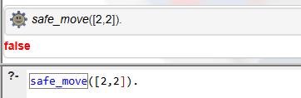
Query:
Find a safe, unvisited neighbor of the current location [1, 2]
The agent wants to move to [2, 2].
Query: ?- safe_move([2, 2]).
Reasoning:
known_not_wampa([2, 2]) is TRUE (since [1, 2] had no stench).
known_not_pit([2, 2]) is FALSE (since [1, 2] had a breeze, [2, 2] is a possible pit).
Conclusion: ?- safe_move([2, 2]) will FAIL.

Slide 7
Neuro-Symbolic AI: Hybrid Architecture
Component | Language | Purpose
Neural Layer (Python) | neuro_driver.py | Produces probabilistic perceptions from the environment (like “there is 0.8 chance of a breeze”).
Symbolic Layer (Prolog) | neuro_symbolic.pl | Uses logical reasoning with those probabilities to decide what’s safe or risky.
Together they form a Neuro-Symbolic AI system — Python handles uncertainty, Prolog handles logic.

Slide 8
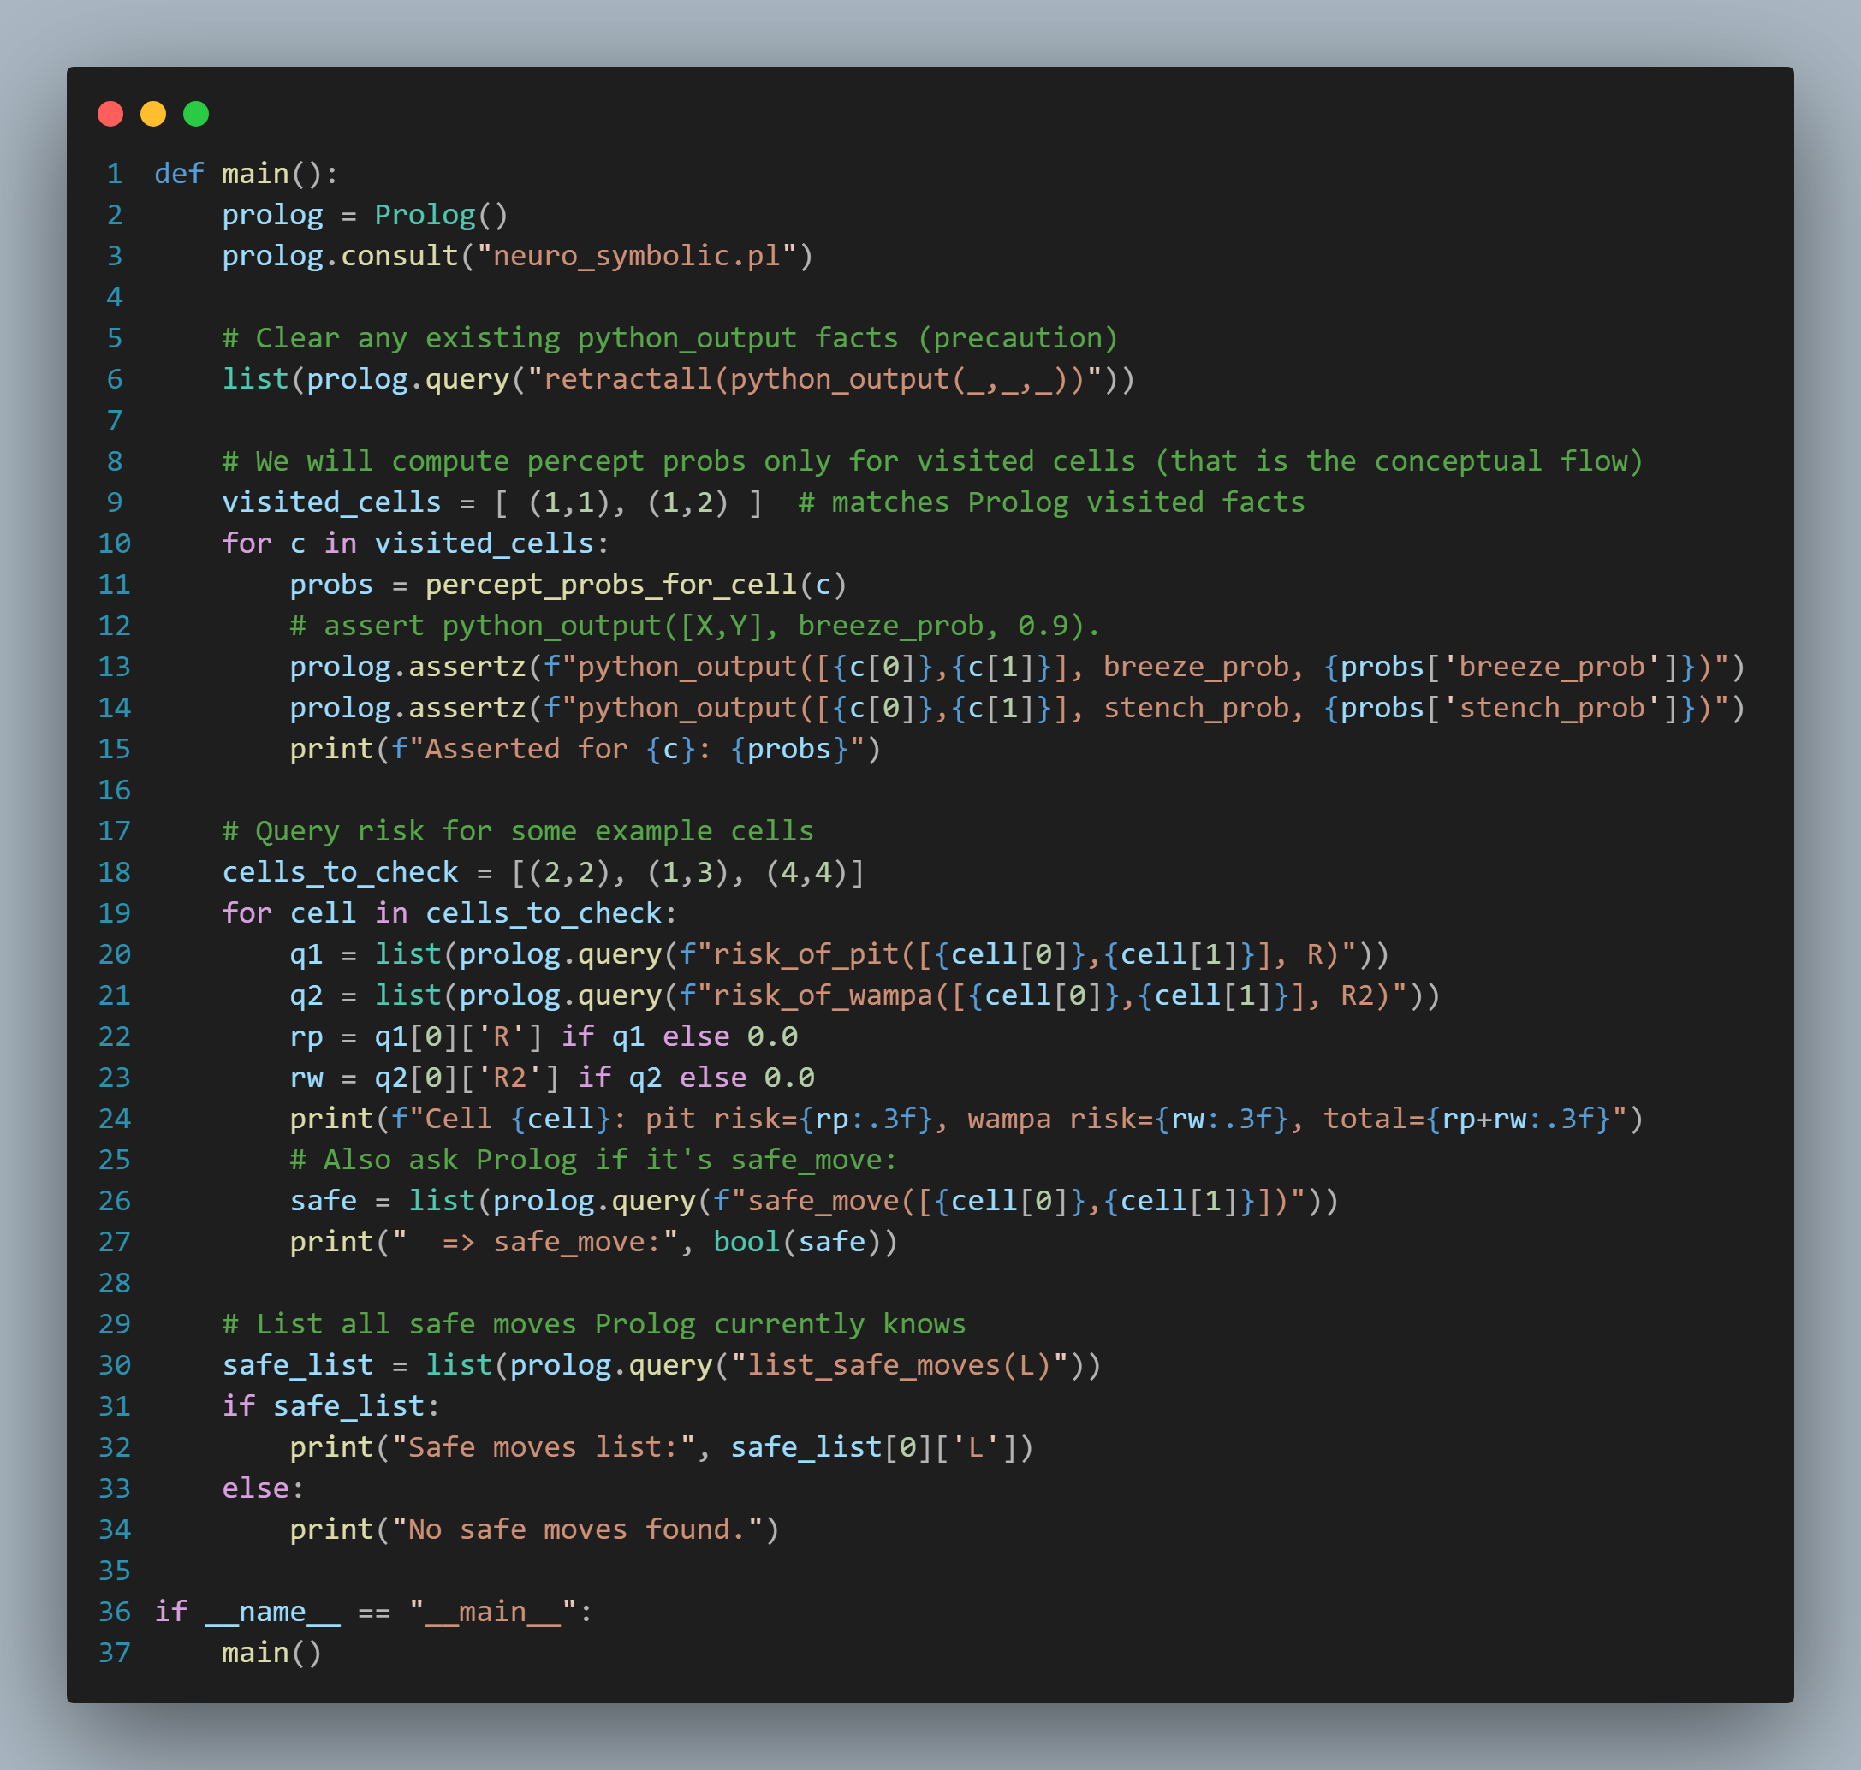
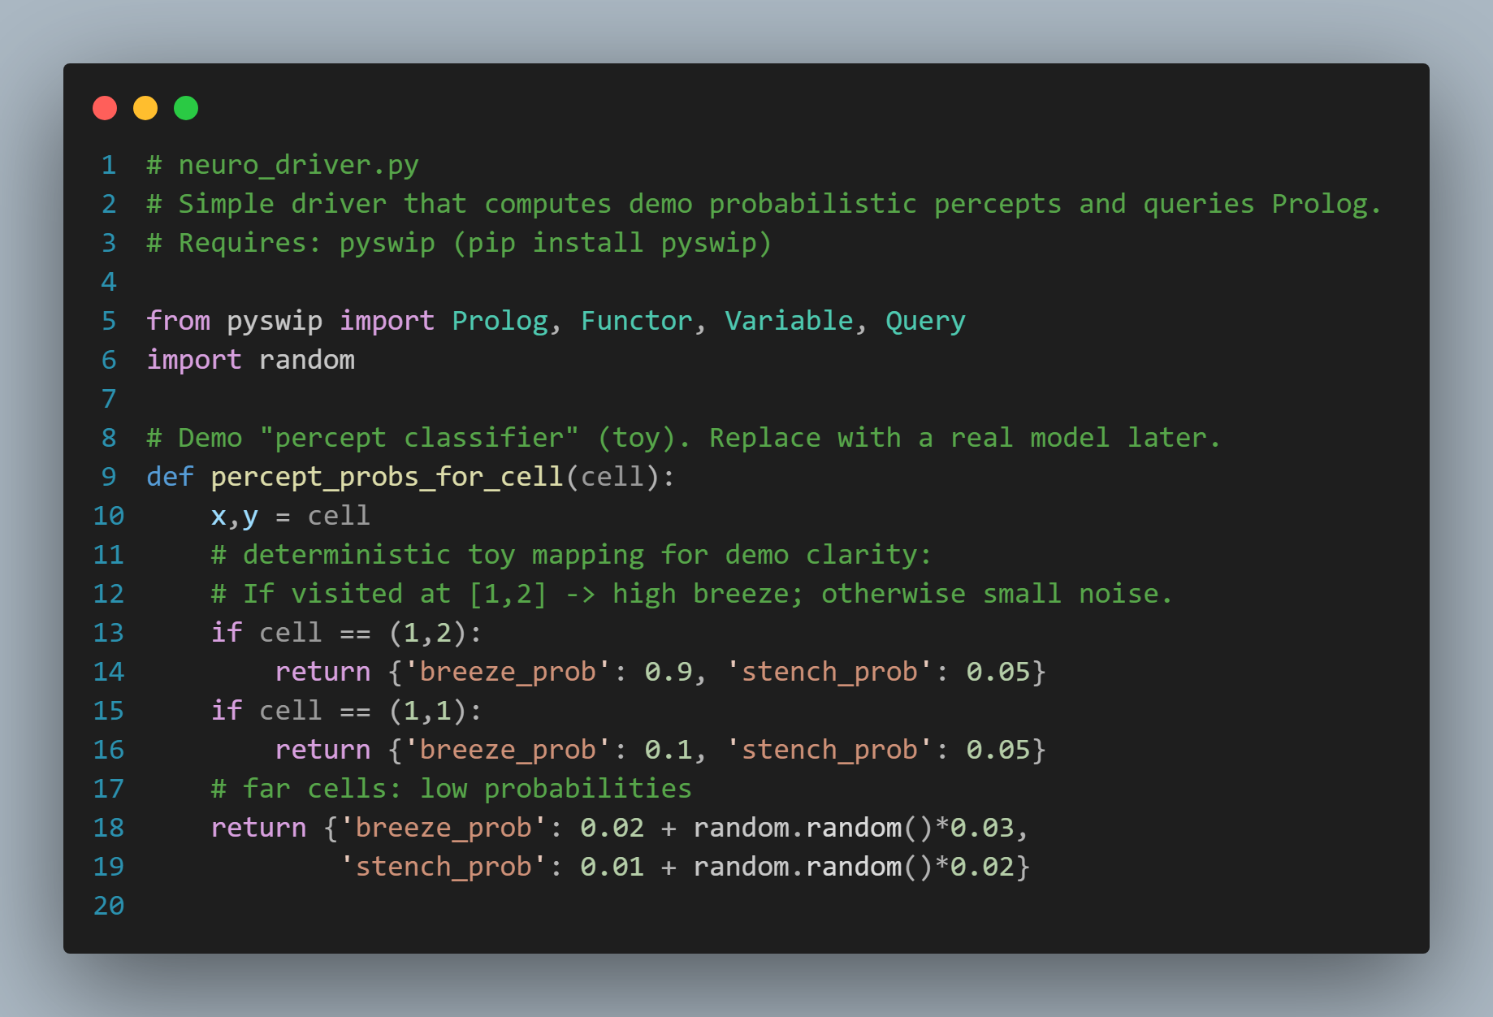
Implementation (CONT.) (neuro_driver.py)
Accessing prolog file to send probabilities
Sending probabilities
Prolog computes risk based on probabilities in neighboring cells.
If the total risk < 0.1, the move is considered safe.
Mimics a trained neural network that outputs probabilities.
Collects all coordinates that are considered safe.

Slide 9
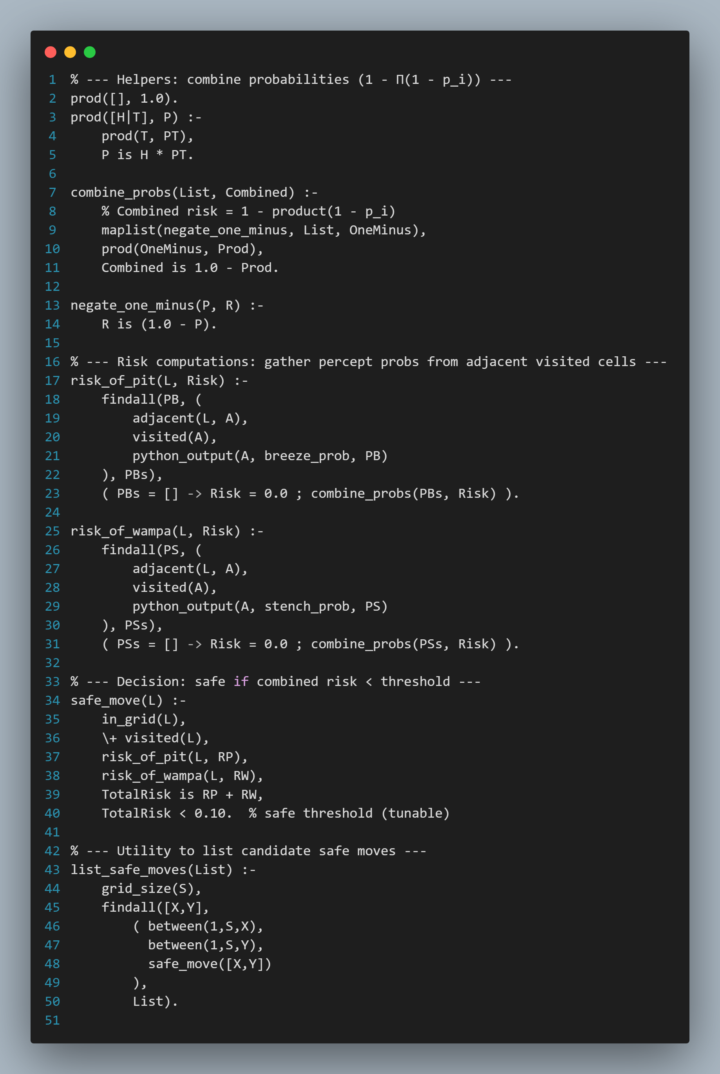
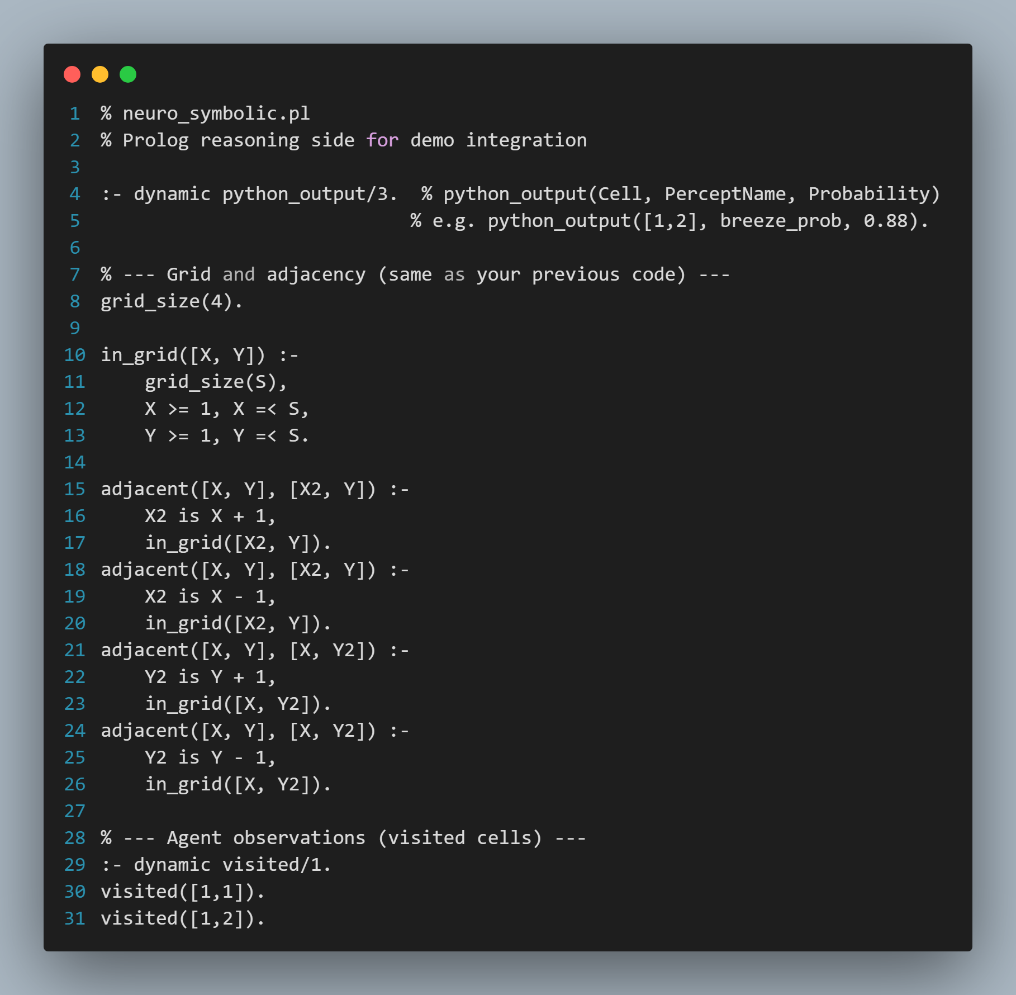
Implementation (neuro_symbolic.pl)
combines evidence from multiple neighbors probabilistically.
Allows facts to be added/removed at runtime (by Python).
Calculate risk for each event
Defines the world as a 4×4 grid and how cells are adjacent.
A move is safe if Combined risk < 10%.
Searches all cells and lists those that satisfy the safe condition.

Slide 10
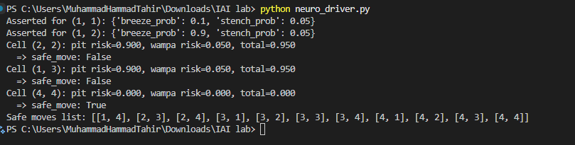
Output

Slide 11
Thank you

